Slide 1

Adaptive Prediction Of Spam Emails
DEPARTMENT OF COMPUTER SCIENCE AND ENGINEERING
BATCH NO:15IOT15
GUIDED BY: BATCH MEMBERS: B Sita Rama Krishna - 150030138
M.L Phaneendra P. Vamshi - 150030497
Associate Professor (C.S.E)

Slide 2
Abstract
We get hundreds of messages each day, it is difficult for us to say which of them are relevant. We face this problem of spam messages every day. Spam severely risks an internet company's reputation. These days, most of the brands and companies use spam as a source of publicity for their products and services. It can be observed in most popular mailing services that spam filters are being biased for the profit from the ads, i.e. they are allowing some exception for some companies that pay for promotion. This is not an ethical practice, but it is very profitable for their business for sure. Our aim is to build a spam detector using machine learning in python with the packages NLTK. it can state a stated message is spam or not. It can be implemented by using Bayes’ Theorem, a simple yet powerful theorem.
Machine learning empowers investigation of huge amounts of information. While it by and large conveys quicker, more precise outcomes with the end goal to distinguish productive chances or perilous dangers, it might likewise require extra time and assets to prepare it appropriately. Consolidating machine learning with AI and subjective advances can make it much more powerful in handling huge volumes of data.
It is important for ever in this technology era to learn how to build small machine learning systems for performing our day to day tasks it improves efficiency and accuracy.
So, our aim is to build and train a system ourselves for the detection of spam with the help of PYTHON packages.

Slide 3

Introduction
Machine learning is a subdivision of Artificial intelligence (AI) that gives frameworks the capacity to certainly take in and enhance as a matter of fact without being expressly modified. Machine learning revolves around the change of PC programs that can get to data and use it learn for themselves.
The way toward learning starts with perceptions or in-formation, for example, models, coordinate understanding, or guidance, with the end goal to search for examples in information and settle on better choices later de-pendent on the precedents that we give. The essential point is to permit the PCs to learn consequently without human mediation or help and alter activities as needs are. Some machine learning techniques
Machine learning algorithms are characterized as un-supervised and supervised.
Supervised machine learning algorithms can apply what has been realized in the past to new information utilizing marked models to foresee future occasions. Be-ginning from the examination of a known preparing dataset, the learning calculation delivers a deduced capacity to make forecasts about the yield esteems. The frame-work can offer concentrations to any new commitment after suitable preparing. The learning calculation can likewise contrast its yield and the right, proposed yield and discover blunders with the end goal to adjust the model in like manner.

Slide 4
/
Interestingly, unsupervised machine learning calculations are utilized when the data used to prepare is neither characterized nor named. Unsupervised learning contemplates how frameworks can derive a capacity to depict a concealed structure from unlabelled information. The framework doesn't make sense of the correct yield, yet it investigates the information and can attract deductions from datasets to depict concealed structures from unlabelled information.
The semi-supervised machine is a class of machine learning assignments and systems that additionally make utilization of unlabelled data for training, normally a little measure of marked data with a lot of unlabelled data. Semi-supervised learning sandwiched between supervised learning and unsupervised learning. Many machinelearning specialists have discovered that unlabelled data, when utilized related to a little measure of labelled data, can deliver impressive change in learning precision over unsupervised learning, however without the time and costs required for supervised learning.
Reinforcement machine learning calculations is a learning technique that associates with its condition by delivering activities and finds mistakes or rewards. Ex-peri mentation seeks and postponed compensate are the most significant attributes of support learning. This technique enables machines and programming operators to consequently decide the perfect conduct inside a setting with the end goal to boost its execution. Basic re-ward input is required for the specialist to realize which activity is ideal; this is known as the Reinforcement signal.
Machine learning enables investigation of enormous amounts of data. While it, for the most part, conveys quicker, more exact outcomes with the end goal to distinguish beneficial chances or perilous dangers, it might likewise require extra time and assets to prepare it appropriately. Joining machine learning with AI and subjective advancements can make it much more viable in processing large volumes of information.

Slide 5

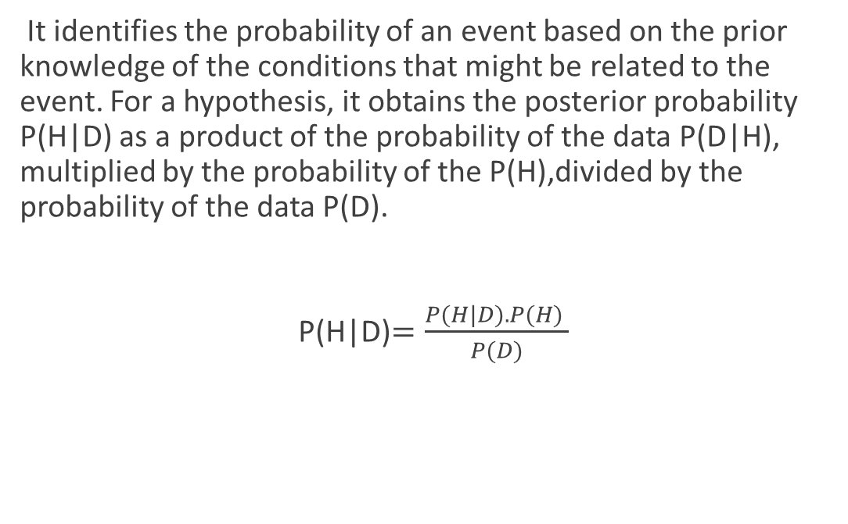
Bayes’ Theorem
It identifies the probability of an event based on the prior knowledge of the conditions that might be related to the event. For a hypothesis, it obtains the posterior probability P(H|D) as a product of the probability of the data P(D|H), multiplied by the probability of the P(H),divided by the probability of the data P(D).
P(H|D)$=\frac{P(H|D).P(H) }{P(D)}$

Slide 6
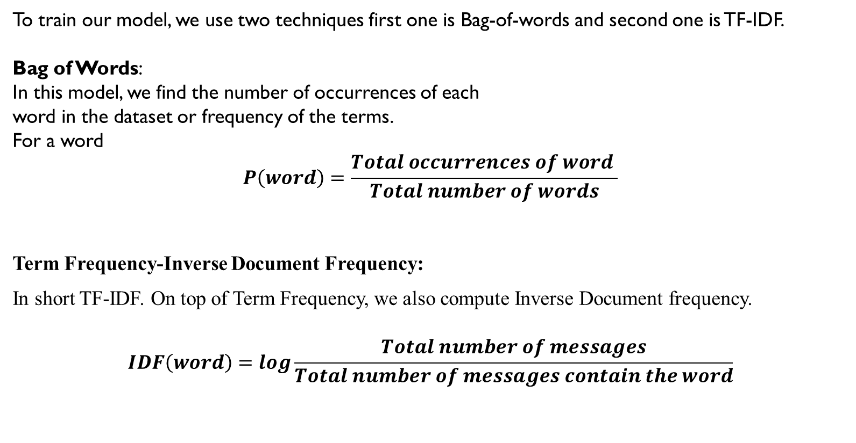
To train our model, we use two techniques first one is Bag-of-words and second one is TF-IDF.
Bag of Words:
In this model, we find the number of occurrences of each
word in the dataset or frequency of the terms.
For a word
$$P\left(word\right)=\frac{Total occurrences of word }{Total number of words}$$
Term Frequency-Inverse Document Frequency:
In short TF-IDF. On top of Term Frequency, we also compute Inverse Document frequency.
$$IDF\left(word\right)=log\frac{Total number of messages}{Total number of messages contain the word}$$

Slide 7
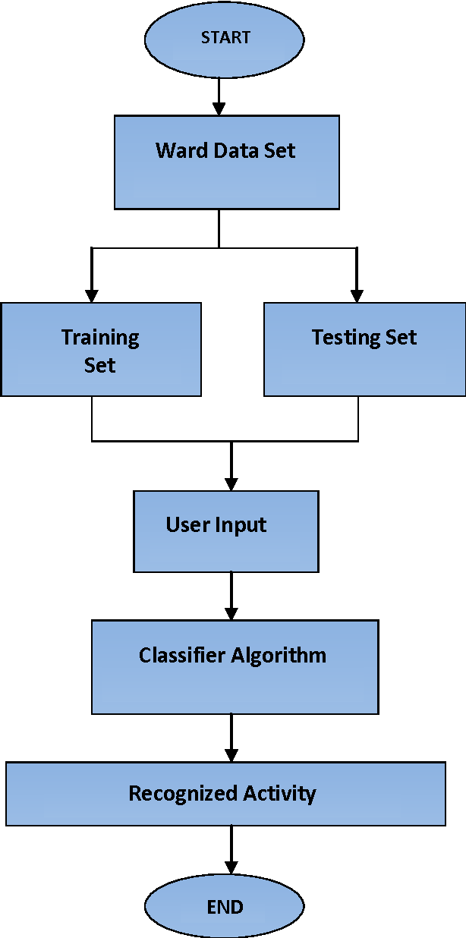

Slide 8
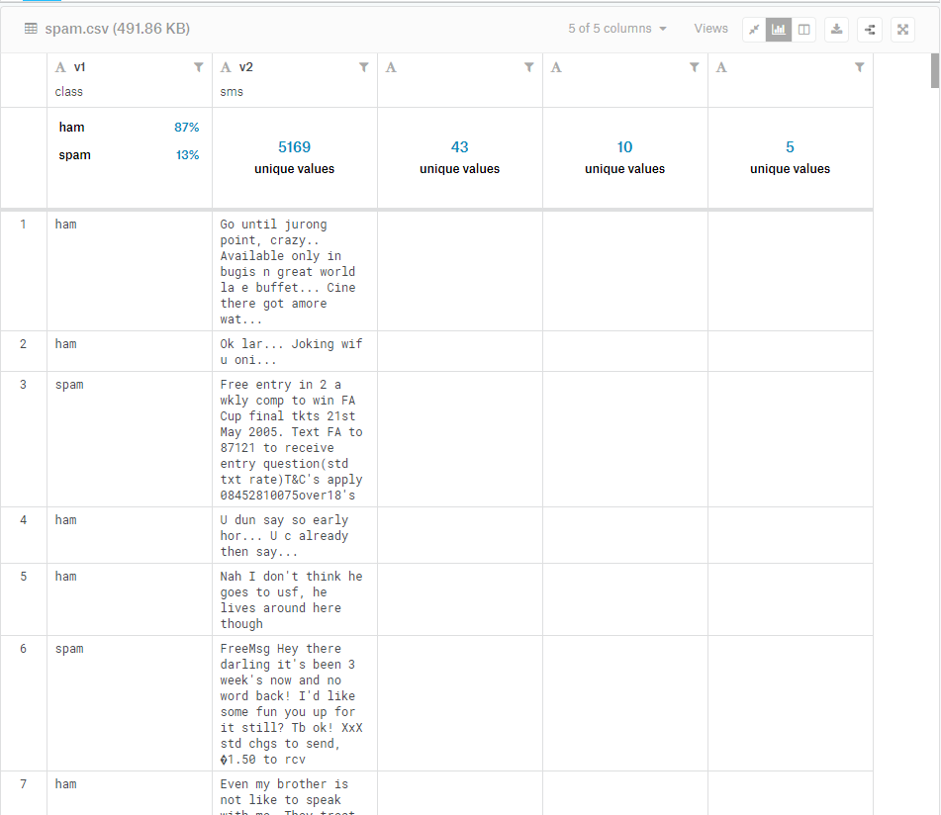
Train-Test Split
To test our model we should split the data into train dataset and test dataset. We shall use the train dataset to train the model and then it will be tested on the test dataset. We shall use 75% of the dataset as train dataset and the rest as test dataset. Selection of this 75% of the data is uniformly random.

Slide 9
Tokenization
Preprocessing Stage :
Before the start of training, we must first preprocess the input messages. We need to convert all the input characters to lowercase. We do this need to treat ‘free’ and ‘FREE’ as the same, if not the model treats them as two different words which lead in the waste of more processing power. Then we split up the text into small pieces and also removing the punctuations. The task of removing punctuations and splitting messages is called Tokenization For example.

Slide 10

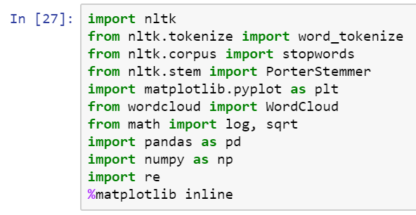

There are some similar words like ‘eat’, ‘eats’, ‘eating’ direct the same activity, we can replace all such words by one word ‘eat’. This process is called stemming. We are going to use the most popular stemming algorithm The Porter-Stemmer.

Slide 11
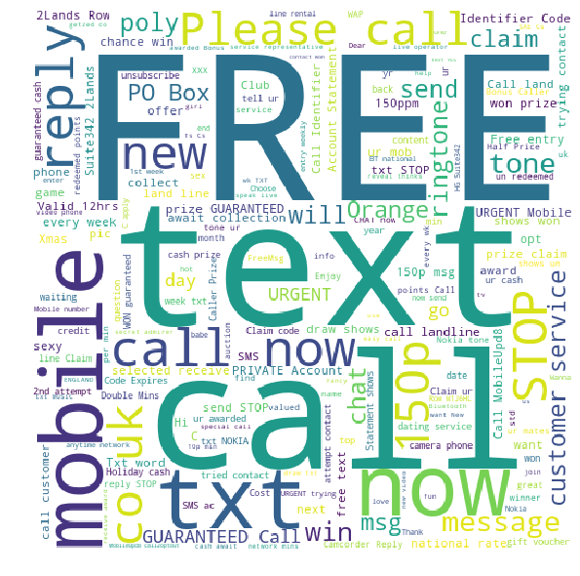
VISUALIZATION OF DATA
We need to find out which words in the spam messages are the most repeated, to do so we use the Word Cloud library
As expected, these messages mostly contain the words like ‘FREE’, ‘call’, ‘text’, ‘ringtone’, ‘prize claim’ etc.
￼

Slide 12
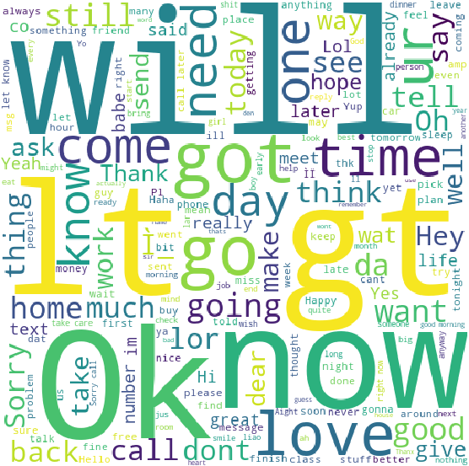
Word Cloud Of Ham Messages

Slide 13
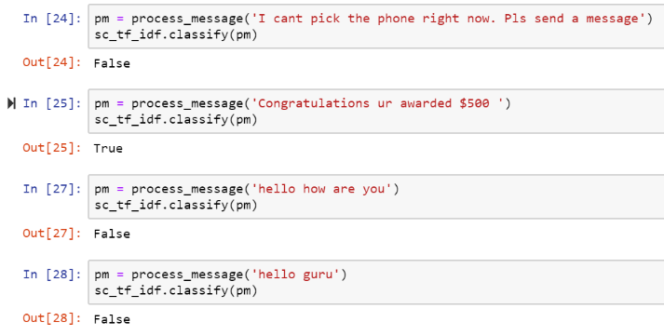
Classification
For classifying a given message, first we preprocess it. For each word w in the processed messaged we find a product of P(w|spam). If w does not exist in the train dataset we take TF(w) as 0 and find P(w|spam) using above formula. We multiply this product with P(spam) The resultant product is the P(spam|message). Similarly, we find P(ham|message). Whichever probability among these two is greater, the corresponding tag (spam or ham) is assigned to the input message. Note than we are not dividing by P(w) as given in the formula. This is because both the numbers will be divided by that and it would not affect the comparison between the two.

Slide 14
References
[1] Trivedi, Shrawan Kumar. "A study of machine learning classifiers for spam detection.“ Computational and Business Intelligence (ISCBI), 2016 4th International Symposium on. IEEE, 2016.
[2] Mujtaba, Ghulam, et al. "Email classification research trends: Review and open issues." IEEE Access 5 (2017).
[3] Rathod, Sunil B., and Tareek M. Pattewar. "Content based spam detection in email using Bayesian classifier." International Conference on. IEEE, 2015.
[4] Amin, Rohan, Julie Ryan, and Johan van Dorp. "Detecting targeted malicious email." IEEE Security & Privacy 10.3 (2012).

Slide 15

END

